Slide 1
Basic Linux Commands

Slide 2
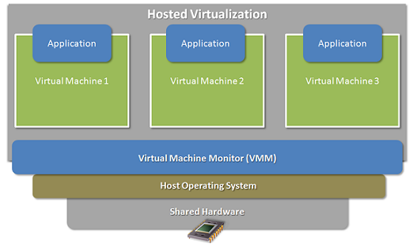
Operating System and VM

Slide 3
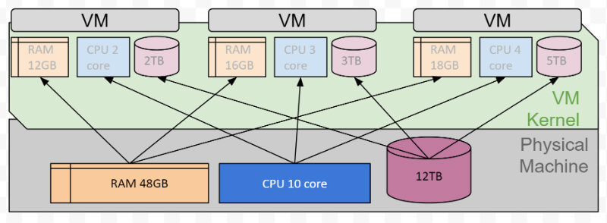
Operating System and VM

Slide 4
Linux file structure

Slide 5
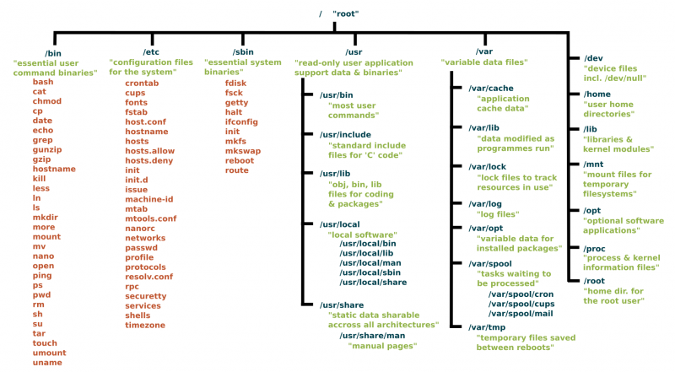
https://www.linux.com/sites/lcom/files/styles/rendered_file/public/standard-unix-filesystem-hierarchy.png?itok=CVqmyk6P

Slide 6
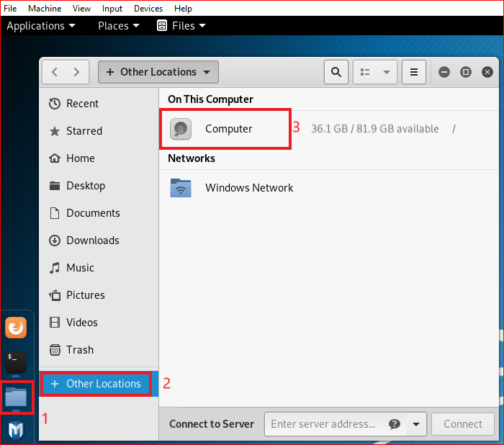

Slide 7
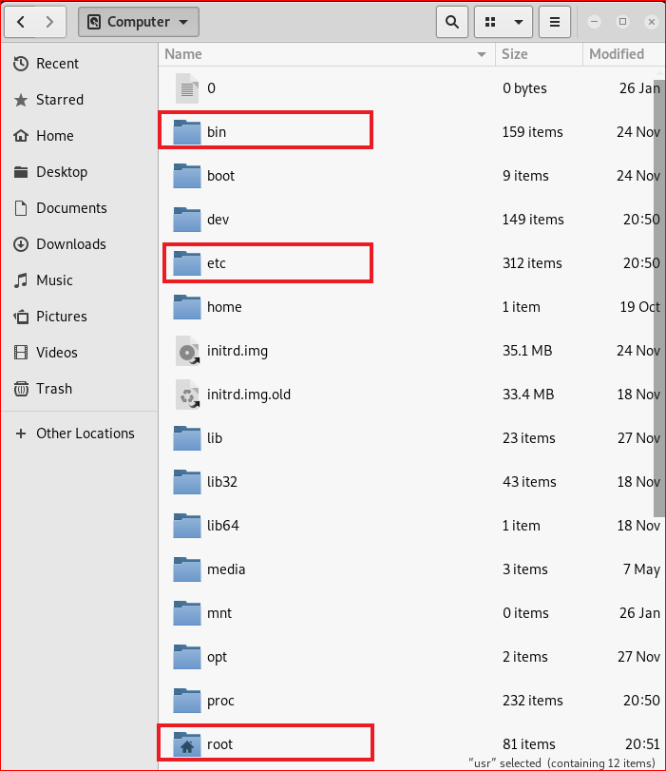

Slide 8
Folders

Slide 9
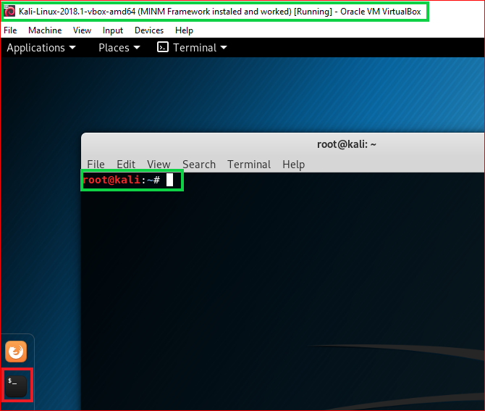

Slide 10
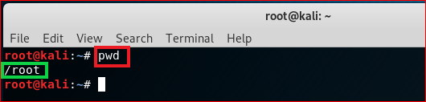
print working directory (pwd)

Slide 11

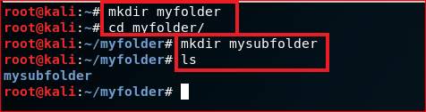
create folders
Root directory
root
\myfolder
\mysubfolder

Slide 12
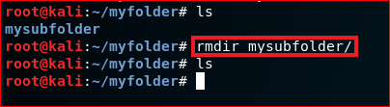
Delete folders

Slide 13
File operations

Slide 14
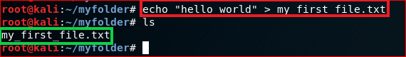
Create a new text file
root
\myfolder
hello world
my_first_file.txt

Slide 15
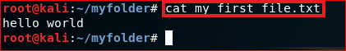
Show the content of the file: cat

Slide 16
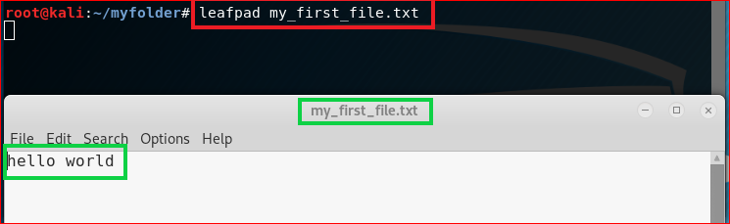
Show the content of the file

Slide 17
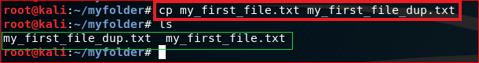
Copy (cp) a file

Slide 18
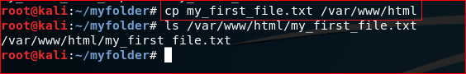
Copy (cp) a file to a different location

Slide 19
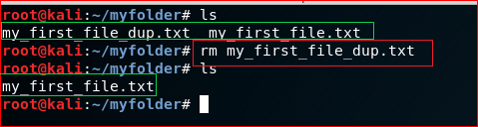
Remove a file: rm

Slide 20
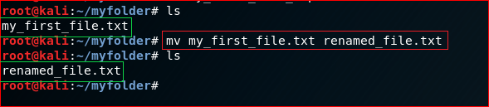
Rename a file (mv)

Slide 21
Networking

Slide 22
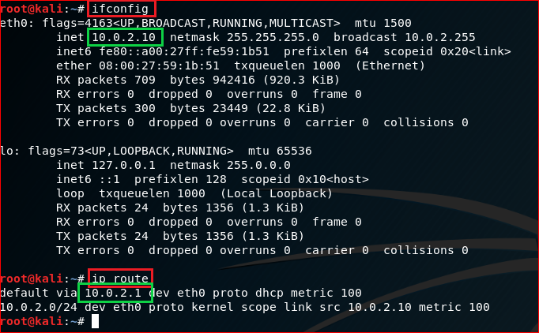
IP default gateway

Slide 23
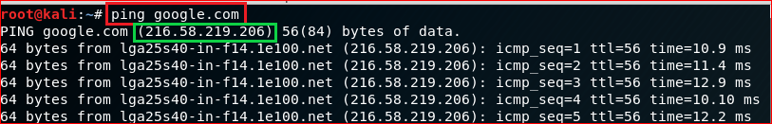
Test network connection using domain name

Slide 24
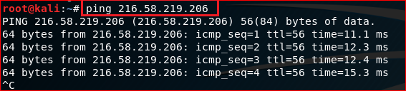
Test network connection using IP

Slide 25
Download files

Slide 26
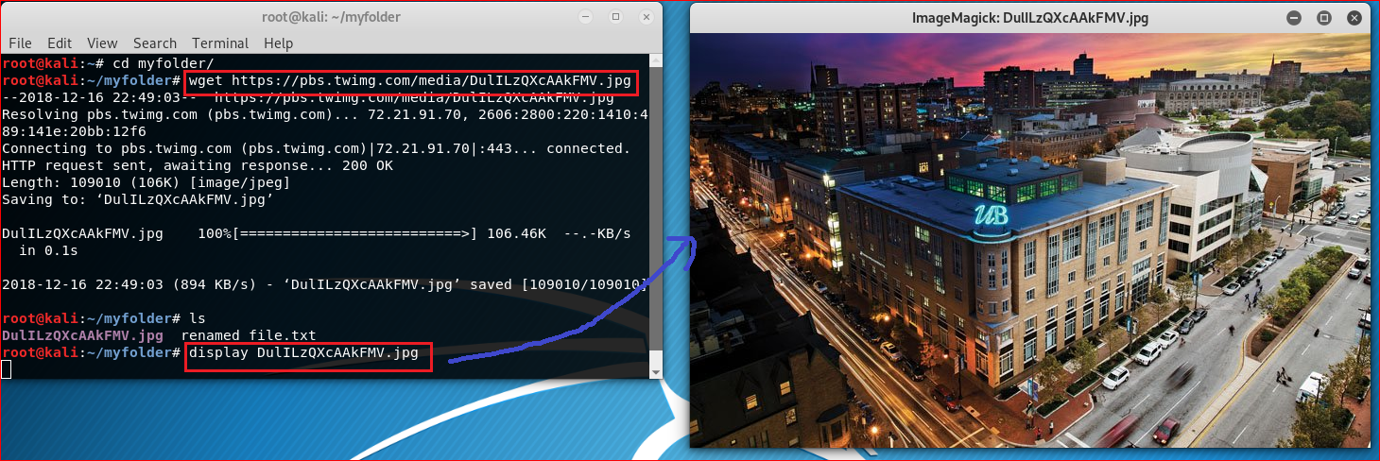
https://pbs.twimg.com/media/DulILzQXcAAkFMV.jpg

Slide 27
Update/Install software

Slide 28
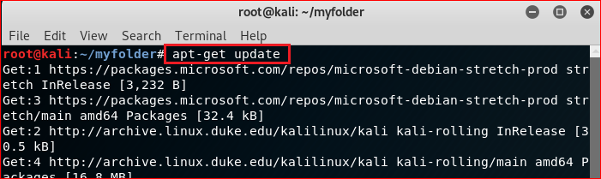
Update software

Slide 29
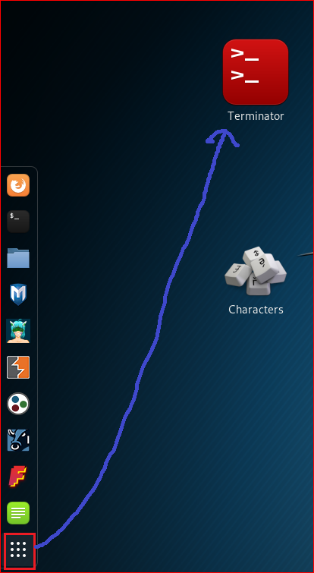
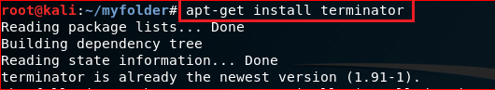
Install terminator

Slide 30
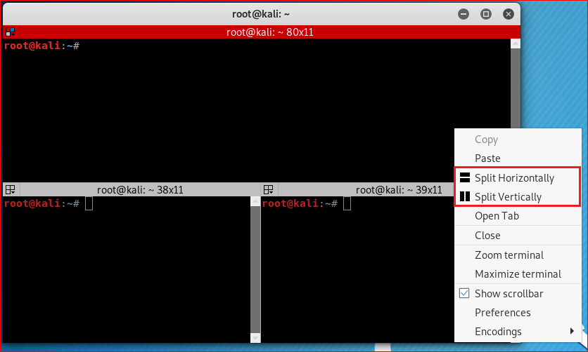

Slide 31
Compress files

Slide 32
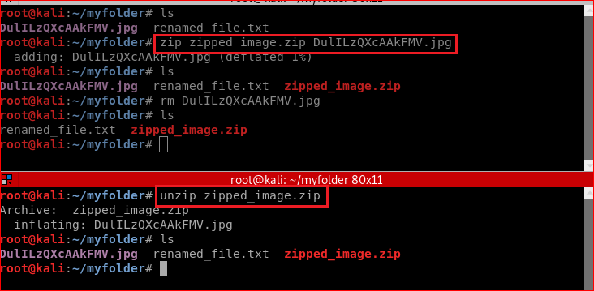
Zip/unzip files

Slide 33
Reference
https://www.linux.com/blog/learn/intro-to-linux/2018/4/linux-filesystem-explained

